Slide 1


Slide 2



dartR Fundamentals
How is genotype data stored
Genlight Object
{adegenet}
Examining contents
Data structure
Interrogation
Subsetting
Basic Filtering Tutorials
Selecting subsets of data for analysis
Basic Filtering
How to learn more
Arthur Georges

Slide 3
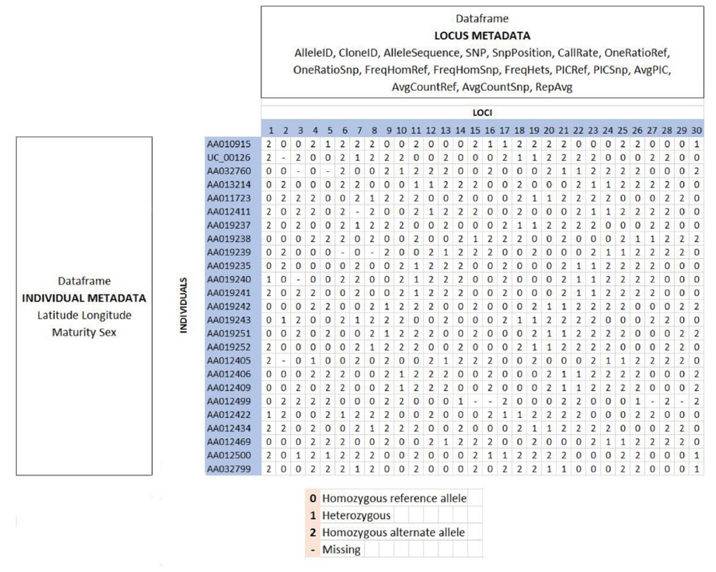
dartR Fundamentals
Data structure
Interrogation
Subsetting
Basic Filtering (refer Renee’s sessions)
Tutorials

Slide 4
dartR Fundamentals
Data structure
Interrogation
Subsetting
Basic Filtering (refer Renee’s sessions)
Tutorials

Slide 5
dartR Fundamentals
gl@other$loc.metrics
Data structure
Interrogation
Subsetting
Basic Filtering (refer Renee’s sessions)
Tutorials
gl@other$ind.metrics
Flags
History
Verbosity Setting
etc
dartR Object
NA

Slide 6

dartR Fundamentals
Quick and Nasty
testset.gl
/// GENLIGHT OBJECT /////////
// 250 genotypes, 255 binary SNPs, size: 752 Kb
7868 (12.34 %) missing data
// Basic content
@gen: list of 250 SNPbin
@ploidy: ploidy of each individual (range: 2-2)
// Optional content
@ind.names: 250 individual labels
@loc.names: 255 locus labels
@loc.all: 255 alleles
@position: integer storing positions of the SNPs
@pop: population of each individual (group size range: 1-11)
@other: a list containing: loc.metrics latlong ind.metrics history loc.metrics.flags
Data structure
Interrogation
Subsetting
Basic Filtering (refer Renee’s sessions)
Tutorials
Follow along if you like. Maybe use your own genlight object?

Slide 7
dartR Fundamentals
{adegenet} Accessors
gl <- testset.gl
nInd(gl)
[1] 250
nLoc(gl)
[1] 250
nPop(gl)
[1] 30
popNames(gl) or indNames(gl) or locNames(gl)
table(pop(gl))
EmmacBrisWive EmmacBurdMist EmmacBurnBara EmmacClarJack EmmacClarYate EmmacCoopAvin EmmacCoopCully
10 10 11 5 5 10 10
EmmacCoopEulb EmmacFitzAllig EmmacJohnWari EmmacMaclGeor EmmacMaryBoru EmmacMaryPetr EmmacMDBBowm
10 10 10 11 6 4 10
EmmacMDBCond EmmacMDBCudg EmmacMDBForb EmmacMDBGwyd EmmacMDBMaci EmmacMDBMurrMung EmmacMDBSanf
10 10 11 9 10 10 10
EmmacNormJack EmmacNormLeic EmmacNormSalt EmmacRichCasi EmmacRoss EmmacRussEube EmmacTweeUki
6 1 1 10 10 10 10
EmsubRopeMata EmvicVictJasp
5 5
as.matrix(gl)[1:7,1:5]
100049687-12-C/T 100049698-16-G/A 100049728-23-A/G 100049805-56-T/A 100049816-51-A/G
AA010915 2 NA 0 0 0
UC_00126 2 NA 0 0 0
AA032760 NA NA 0 0 0
AA013214 2 NA 0 0 0
AA011723 2 NA 0 0 0
AA012411 2 NA 0 0 0
AA019237 2 NA 0 0 0
Data structure
Interrogation
Subsetting
Basic Filtering (refer Renee’s sessions)
Tutorials

Slide 8
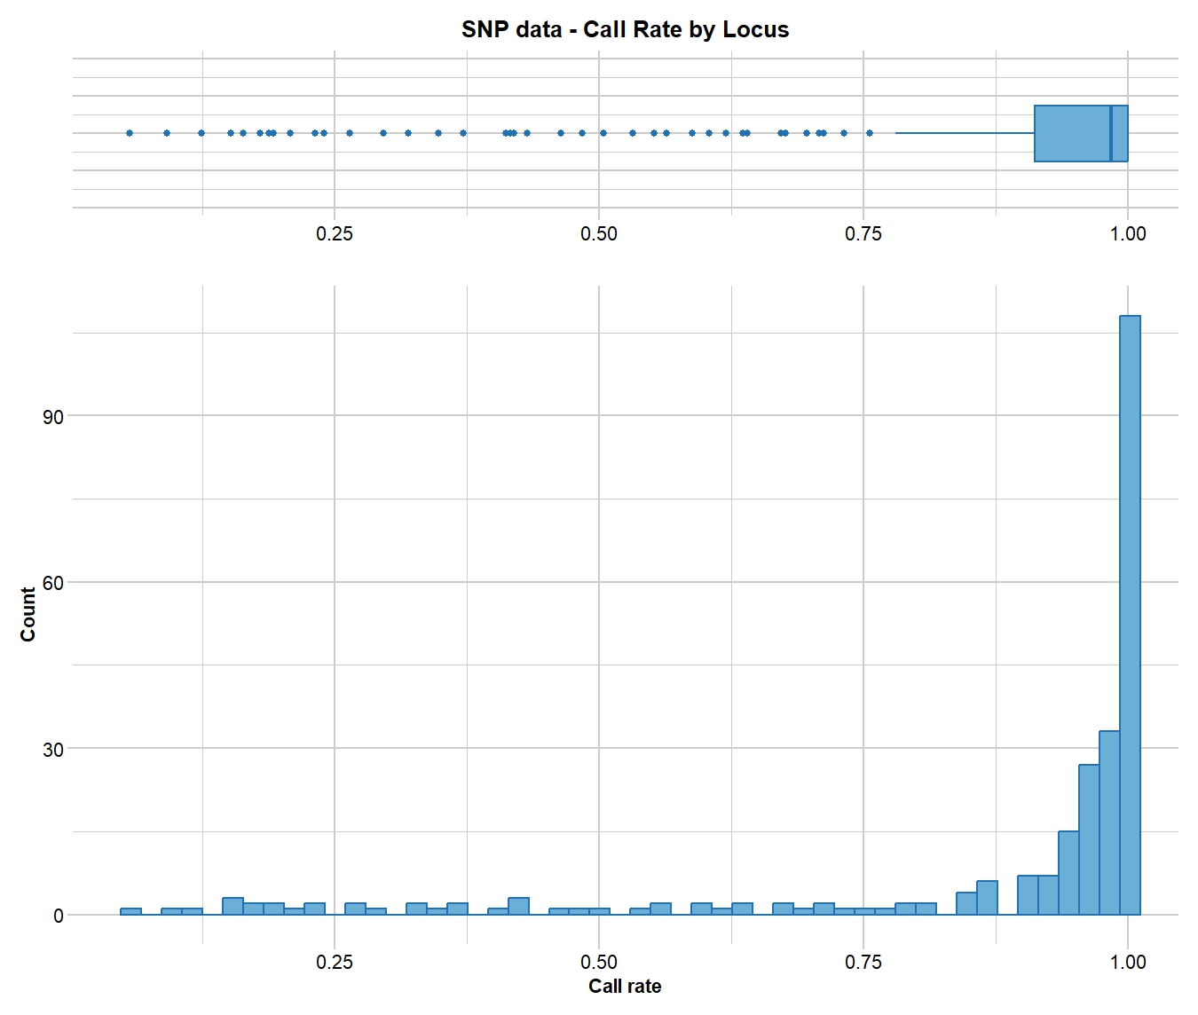
dartR Fundamentals
gl.report functions
gl <- testset.gl
gl.set.verbosity(3)
gl.report.callrate(gl)
[Starting gl.report.callrate
Processing genlight object with SNP data
Reporting Call Rate by Locus
No. of loci = 255
No. of individuals = 250
Minimum : 0.056
1st quartile : 0.912
Median : 0.984
Mean : 0.8765804
3r quartile : 1
Maximum : 1
Missing Rate Overall: 0.1234
Completed: gl.report.callrate
Data structure
Interrogation
Subsetting
Basic Filtering (refer Renee’s sessions)
Tutorials
Filter
out?

Slide 9
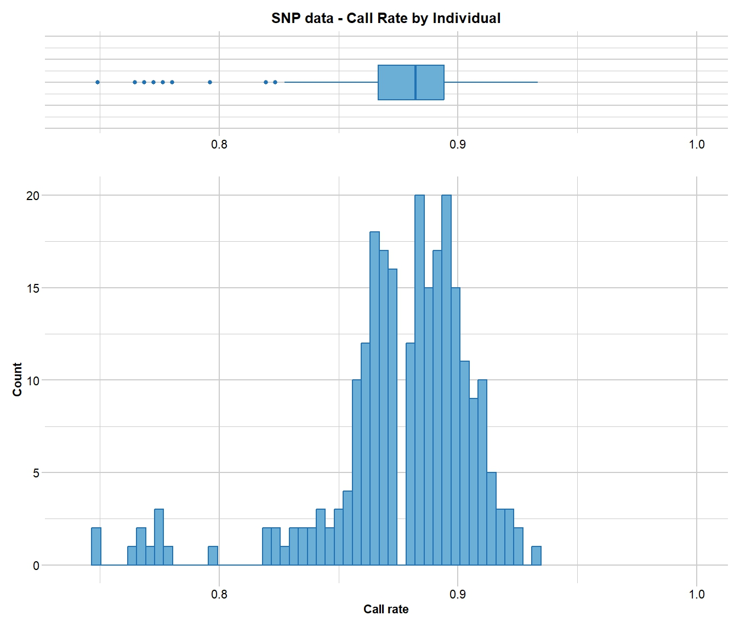
dartR Fundamentals
gl.report functions
gl <- testset.gl
gl.set.verbosity(3)
gl.report.callrate(gl)
gl.report.callrate(gl,method="ind")
Starting gl.report.callrate
Processing genlight object with SNP data
Reporting Call Rate by Individual
Listing 30 populations and their average CallRates
Monitor again after filtering
Population CallRate N
1 EmmacBrisWive 0.8839 10
2 EmmacBurdMist 0.8808 10
3 EmmacBurnBara 0.8859 11
……….
Listing 20 individuals with the lowest CallRates
Use this list to see which individuals will be lost on filtering by individual
Individual CallRate
1 AA063722 0.7490196
2 AA063726 0.7490196
3 AA063732 0.7647059
……….
Completed: gl.report.callrate
Data structure
Interrogation
Subsetting
Basic Filtering (refer Renee’s sessions)
Tutorials
Filter
out?
Who will be lost?

Slide 10
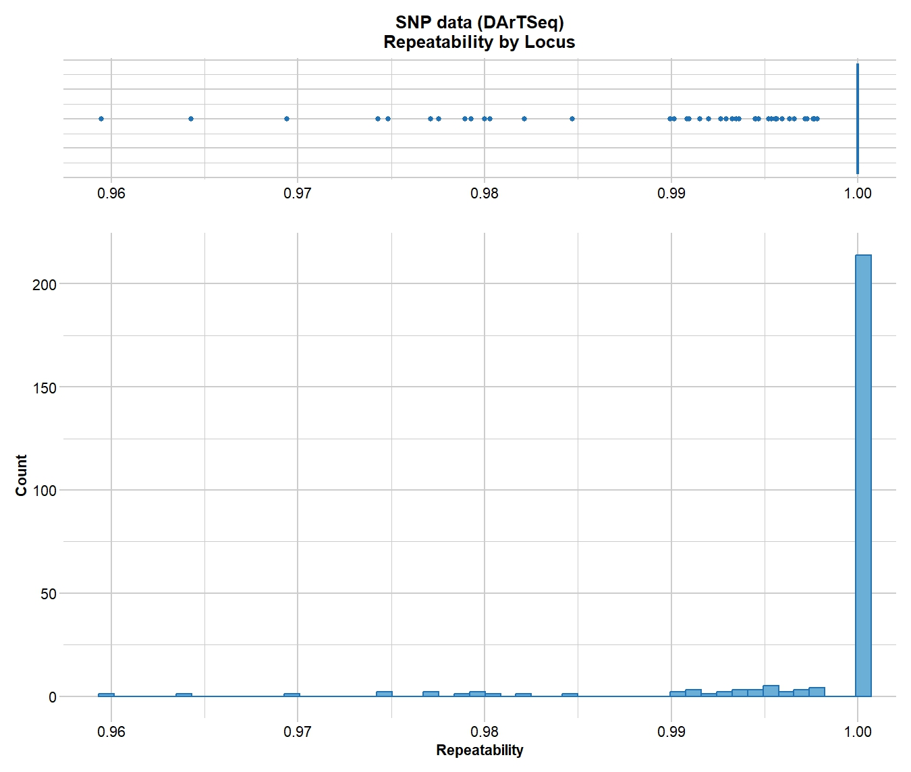
dartR Fundamentals
gl.report functions
gl <- testset.gl
gl.set.verbosity(3)
gl.report.callrate(gl)
gl.report.callrate(gl,method="ind")
gl.report.reproducibility(gl
gl.report.reproducibility(gl)
Starting gl.report.reproducibility
Processing genlight object with SNP data
Reporting Repeatability by Locus
No. of loci = 255
No. of individuals = 250
Minimum : 0.959459
1st quartile : 1
Median : 1
Mean : 0.9981525
3r quartile : 1
Maximum : 1
Missing Rate Overall: 0.12
Quantile Threshold Retained Percent Filtered Percent
1 100% 1.000000 214 83.9 41 16.1
……………
17 20% 1.000000 214 83.9 41 16.1
18 15% 0.997674 217 85.1 38 14.9
19 10% 0.994536 230 90.2 25 9.8
20 5% 0.984694 243 95.3 12 4.7
21 0% 0.959459 255 100.0 0 0.0
Completed: gl.report.reproducibility
Data structure
Interrogation
Subsetting
Basic Filtering (refer Renee’s sessions)
Tutorials
Filter
out?

Slide 11

dartR Fundamentals
Keep up …
testset.gl
gl <- testset.gl
nInd(gl)
nLoc(gl)
nPop(gl)
popNames(gl)
indNames(gl)
locNames(gl)
table(pop(gl))
as.matrix(gl)[1:7,1:5]
gl <- testset.gl
gl.set.verbosity(3)
gl.report.callrate(gl)
gl.report.callrate(gl,method="ind")
gl.report.reproducibility(gl)
You get the gist …..
gl.report.callrate()
gl.report.reproducibility()
gl.report.secondaries()
gl.report.rdepth()
gl.report.monomorphs()
gl.report.overhang()
gl.report.hamming()
gl.report.overshoot()
gl.report.locmetric()
……………………. etc
Data structure
Interrogation
Subsetting
Basic Filtering (refer Renee’s sessions)
Tutorials
Try some of these in your own time

Slide 12
dartR Fundamentals
Keep up …
testset.gl
gl <- testset.gl
nInd(gl)
nLoc(gl)
nPop(gl)
popNames(gl)
indNames(gl)
locNames(gl)
table(pop(gl))
as.matrix(gl)[1:7,1:5]
gl <- testset.gl
gl.set.verbosity(3)
gl.report.callrate(gl)
gl.report.callrate(gl,method="ind")
gl.report.reproducibility(gl)
Subsetting your data
gl.keep.ind()
gl.drop.ind()
gl.keep.loc()
gl.drop.loc()
gl.keep.pop()
gl.drop.pop()
gl.merge.pop()
gl.subsample.ind()
gl.subsample.loc()
……………………. etc
Data structure
Interrogation
Subsetting
Basic Filtering (refer Renee’s sessions)
Tutorials
Try some of these in your own time

Slide 13
dartR Fundamentals
Keep up …
testset.gl
gl <- testset.gl
nInd(gl)
nLoc(gl)
nPop(gl)
popNames(gl)
indNames(gl)
locNames(gl)
table(pop(gl))
as.matrix(gl)[1:7,1:5]
gl <- testset.gl
gl.set.verbosity(3)
gl.report.callrate(gl)
gl.report.callrate(gl,method="ind")
gl.report.reproducibility(gl)
Recall …..
gl.report.callrate()
gl.report.reproducibility()
gl.report.secondaries()
gl.report.rdepth()
gl.report.monomorphs()
gl.report.overhang()
gl.report.hamming()
gl.report.overshoot()
gl.report.locmetric()
……………………. etc
Data structure
Interrogation
Subsetting
Basic Filtering (refer Renee’s sessions)
Tutorials

Slide 14
dartR Fundamentals
Keep up …
testset.gl
gl <- testset.gl
nInd(gl)
nLoc(gl)
nPop(gl)
popNames(gl)
indNames(gl)
locNames(gl)
table(pop(gl))
as.matrix(gl)[1:7,1:5]
gl <- testset.gl
gl.set.verbosity(3)
gl.report.callrate(gl)
gl.report.callrate(gl,method="ind")
gl.report.reproducibility(gl)
Basic Filtering
gl <- gl.filter.callrate()
gl <- gl.filter.reproducibility()
gl <- gl.filter.secondaries()
gl <- gl.filter.rdepth()
gl <- gl.filter.monomorphs()
gl <- gl.filter.overhang()
gl <- gl.filter.hamming()
gl <- gl.filter.overshoot()
gl <- gl.report.locmetric()
……………………. etc
Data structure
Interrogation
Subsetting
Basic Filtering (refer Renee’s sessions)
Tutorials

Slide 15
dartR Fundamentals
Recall …..
gl <- testset.gl
gl.set.verbosity(3)
gl.report.callrate(gl)
gl.report.callrate(gl,method="ind")
Starting gl.report.callrate
Processing genlight object with SNP data
Reporting Call Rate by Individual
Listing 30 populations and their average CallRates
Monitor again after filtering
Population CallRate N
1 EmmacBrisWive 0.8839 10
2 EmmacBurdMist 0.8808 10
3 EmmacBurnBara 0.8859 11
……….
Listing 20 individuals with the lowest CallRates
Use this list to see which individuals will be lost on filtering by individual
Individual CallRate
1 AA063722 0.7490196
2 AA063726 0.7490196
3 AA063732 0.7647059
……….
Completed: gl.report.callrate
Data structure
Interrogation
Subsetting
Basic Filtering (refer Renee’s sessions)
Tutorials
Filter
out?
Who will be lost?

Slide 16
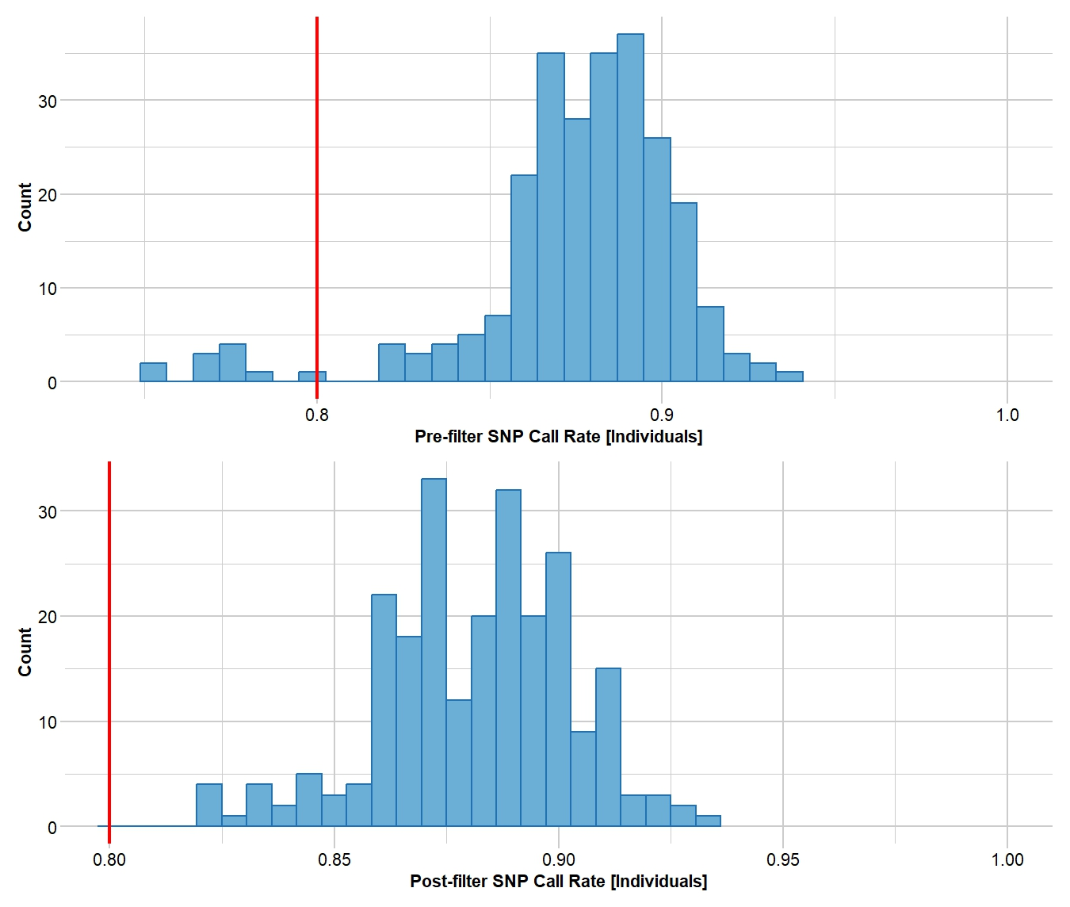
dartR Fundamentals
gl.filter functions
gl <- testset.gl
gl.set.verbosity(3)
gl.report.callrate(gl)
gl.report.callrate(gl,method="ind")
gl <- gl.filter.callrate(gl,method=“ind”,threshold=0.80)
Starting gl.filter.callrate
Processing genlight object with SNP data
Warning: Data may include monomorphic loci in call rate
calculations for filtering
Recalculating Call Rate
Removing individuals based on Call Rate, threshold = 0.8
Individuals deleted (CallRate <= 0.8 ):
AA032760[EmmacMDBMaci], AA063718[EmmacCoopAvin], AA063720[EmmacCoopAvin], AA063722[EmmacCoopAvin], AA063726[EmmacCoopAvin], AA063732[EmmacCoopAvin], AA063708[EmmacCoopAvin], AA063710[EmmacCoopAvin], AA063712[EmmacCoopAvin], AA063714[EmmacCoopAvin], AA063716[EmmacCoopAvin],
Note: Locus metrics not recalculated
Note: Resultant monomorphic loci not deleted
Completed: gl.filter.callrate
Data structure
Interrogation
Subsetting
Basic Filtering (refer Renee’s sessions)
Tutorials
Who has been discarded?

Slide 17
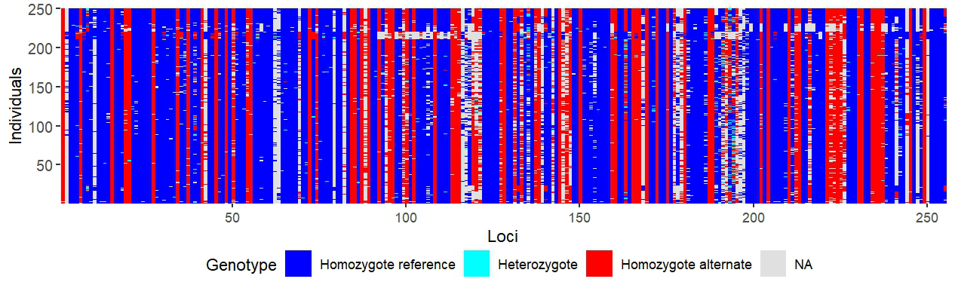
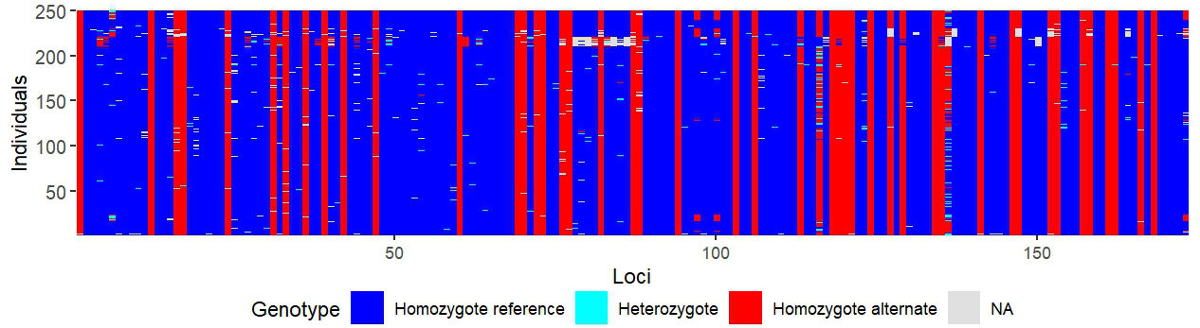
dartR Fundamentals
Quick graphical evaluation
gl <- testset.gl
gl.smearplot(gl)
Data structure
Interrogation
Subsetting
Basic Filtering (refer Renee’s sessions)
Tutorials
gl <- gl.filter.callrate(gl,verbose=0)
gl <- gl.filter.callrate(gl,method=“ind”,threshold=0.80,verbose=0)
gl.smearplot(gl)

Slide 18
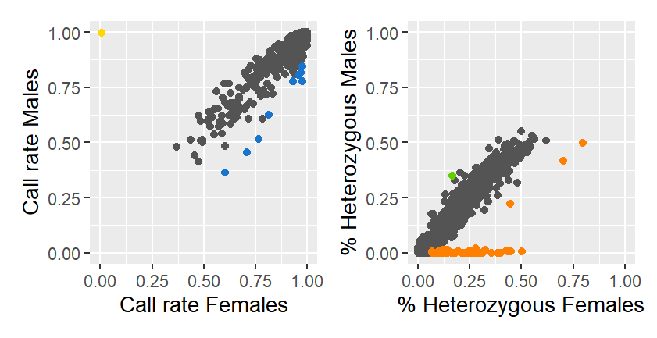
dartR Fundamentals
dartR.sexlinked
out <- gl.report.sexlinked(gl, system = “xy”)
gl@other$ind.metrics
At least 15 males and 15 females
Starting dartR.sexlinked
Starting gl.drop.sexlinked
Processing genlight object with SNP data
Detected 162 females and 211 males.
Starting phase 1. May take a while...
Building call rate plots.
Starting phase 2. May take a while...
Building heterozygosity plots.
Done building heterozygosity plots.
**FINISHED**
Total of analyzed loci: 1000.
Found 77 sex-linked loci:
1 Y-linked loci (yellow)
9 sex-biased loci (blue)
66 X-linked loci (orange)
1 gametologs (green)
And kept 923 autosomal loci (grey).
Completed: :: Completed: dartR.sexlinked Completed: gl.drop.sexlinked
Data structure
Interrogation
Subsetting
Basic Filtering (refer Renee’s sessions)
Tutorials
View(out)
gl.drop.sexlinked(gl, system = “xy”)
gl.keep.sexlinked(gl, system = “xy”)
Before all other filters!

Slide 19
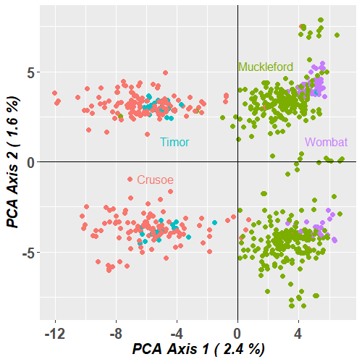
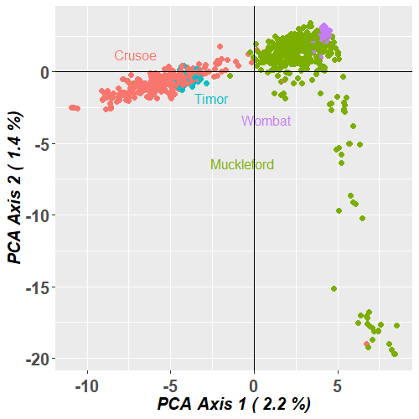
Males
Females

Slide 20

dartR Fundamentals
Basic Filtering
gl <- gl.filter.callrate()
gl <- gl.filter.reproducibility()
gl <- gl.filter.secondaries()
gl <- gl.filter.rdepth()
gl <- gl.filter.monomorphs()
gl <- gl.filter.overhang()
gl <- gl.filter.hamming()
gl <- gl.filter.overshoot()
gl <- gl.report.locmetric()
……………………. etc
Keep up …
testset.gl
gl <- testset.gl
nInd(gl)
nLoc(gl)
nPop(gl)
popNames(gl)
indNames(gl)
locNames(gl)
table(pop(gl))
as.matrix(gl)[1:7,1:5]
gl <- testset.gl
gl.set.verbosity(3)
gl.report.callrate(gl)
gl.report.callrate(gl,method="ind")
gl.report.reproducibility(gl)
gl.report.callrate(gl,method="ind")
gl <- gl.filter.callrate(gl, method=“ind”, threshold=0.80)
gl <- testset.gl
gl.smearplot(gl)
gl <- gl.filter.callrate(gl,verbose=0)
gl <- gl.filter.callrate(gl, method=“ind”, threshold=0.80, verbose=0)
gl.smearplot(gl)
Data structure
Interrogation
Subsetting
Basic Filtering (refer Renee’s sessions)
Tutorials
Try some of these in your own time

Slide 21



dartR Fundamentals
Tutorials
Keep up …
testset.gl
gl <- testset.gl
nInd(gl)
nLoc(gl)
nPop(gl)
popNames(gl)
indNames(gl)
locNames(gl)
table(pop(gl))
as.matrix(gl)[1:7,1:5]
gl <- testset.gl
gl.set.verbosity(3)
gl.report.callrate(gl)
gl.report.callrate(gl,method="ind")
gl.report.reproducibility(gl)
gl.report.callrate(gl,method="ind")
gl <- gl.filter.callrate(gl, method=“ind”, threshold=0.80)
gl <- testset.gl
gl.smearplot(gl)
gl <- gl.filter.callrate(gl,verbose=0)
gl <- gl.filter.callrate(gl, method=“ind”, threshold=0.80, verbose=0)
gl.smearplot(gl)
Data structure
Interrogation
Subsetting
Basic Filtering (refer Renee’s sessions)
Tutorials
inline help
?function
CRAN documentation

Slide 22

Conclusion
Where have we come?
Keep up …
testset.gl
gl <- testset.gl
nInd(gl)
nLoc(gl)
nPop(gl)
popNames(gl)
indNames(gl)
locNames(gl)
table(pop(gl))
as.matrix(gl)[1:7,1:5]
gl <- testset.gl
gl.set.verbosity(3)
gl.report.callrate(gl)
gl.report.callrate(gl,method="ind")
gl.report.reproducibility(gl)
gl.report.callrate(gl,method="ind")
gl <- gl.filter.callrate(gl, method=“ind”, threshold=0.80)
gl <- testset.gl
gl.smearplot(gl)
gl <- gl.filter.callrate(gl,verbose=0)
gl <- gl.filter.callrate(gl, method=“ind”, threshold=0.80, verbose=0)
gl.smearplot(gl)
Discussion

